Slide 1

Phishing Website Detection Internship
End-to-End Machine Learning and Deployment
SR
by Shailaja Ramteke

Slide 2

Project Objectives
1
Understand Phishing
Deep dive into phishing websites.
2
Build & Deploy ML
Create and implement a model.
3
Production-Ready
Deliver a functional solution.

Slide 3







Project Workflow
Problem Understanding
Data Exploration (EDA)
Data Preprocessing
Feature Engineering
Model Training & Evaluation
Model Explainability
Deployment

Slide 4
Data Exploration & Insights
Data Overview
Visual Patterns
X records, Y features.
Heatmap, histogram, pairplot examples.
Key features: length_url, nb_dots, domain_age.
Identified phishing patterns.

Slide 5
Model Development
Models Explored
Final Choice
Reasoning
Logistic Regression, Decision Tree, Random Forest.
Random Forest Classifier.
Best accuracy and interpretability trade-off.
Hyperparameters: n_estimators=100, random_state=42.

Slide 6
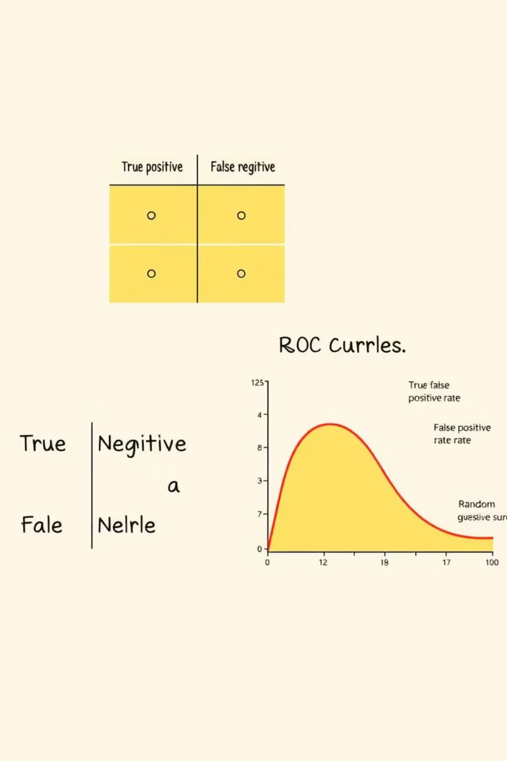
Model Evaluation
Results Summary :-
Model Accuracy Precision Recall F1-Score ROC-AUC
Logistic Regression
0.93 0.92 0.94 0.93 0.97
Decision Tree
0.89 0.88 0.90 0.89 0.90
Random Forest
0.95 0.94 0.96 0.95 0.98

Slide 7
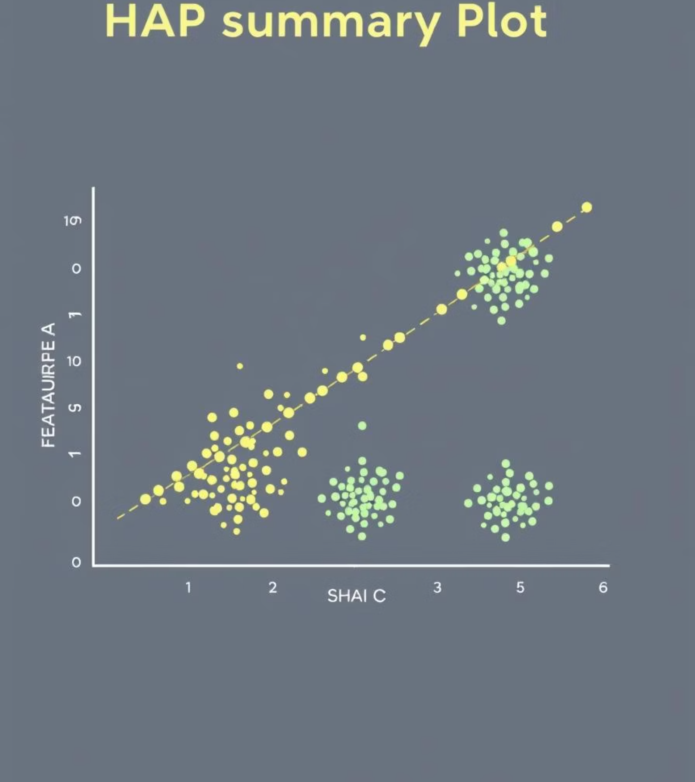




Model Explainability
SHAP Used
Length_URL
Feature importance analysis.
Top influential feature.
Nb_Dots
Domain_Age
Key indicator.
Significant factor.

Slide 8
Deployment & Learnings
1
Local Deployment
Flask app with /predict and /explain endpoints.
2
Cloud Option
AWS EC2 planned.
3
Dockerized App
Ensures portability.

